Slide 1
Brunel’s Other Bridge The dangers of a walk round the Docks
The West of England Branch Project
www.brunelsotherbridge.org.uk

Slide 2
The Bridge – looking smart
www.brunelsotherbridge.org.uk

Slide 3
The Bridge
Introduction
The swing bridge was designed and built in 1849 – the same year the 1st Bowler hat was sold, made by T & W Bowler
Manufactured in the Great Western dry dock from where the SS Great Britain was launched in 1843 after 4yrs of construction
It is a cantilever design with a cunning set of tie bars in the upper cavity to minimise the total mass of the structure
It ceased operation in the early 1960’s, was saved from demolition and now is to be restored as a pedestrian and cycle crossing
www.brunelsotherbridge.org.uk

Slide 4
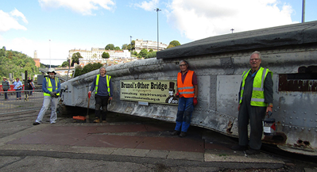
Brunel’s Other Bridge
Foolishly I took a little too much interest in a group of old boys in overalls crawling over a large pile of boiler plate and rivets in 2019.
A casual question of ‘What are the problems?’ resulted in our project to measure the remaining metal thickness over the whole pile.
www.brunelsotherbridge.org.uk

Slide 5
The problem
Original drawings are available
Internal corrosion has occurred
Remaining wall thickness needs to be assessed.
Also there is severe external corrosion on the underside
Material: Wrought Iron
Nominal wall section ½”
No funding
www.brunelsotherbridge.org.uk

Slide 6
The Story so far
2012 Prof. Bruce Drinkwater assesses ultrasonics and reasonable signals were obtained using 1st & 2nd repeat echos and a report supplied. No further action taken by the restorers.
2018 Casual walk resulted in Branch involvement
Sept 2019 Meeting at the bridge to discuss a way forward
Pulsed E/C likely for the plane plate areas
Single point UT for curved and riveted regions
Then review the areas that cannot be measured
Covid 19 struck so next visit was 6th April 2021
www.brunelsotherbridge.org.uk

Slide 7
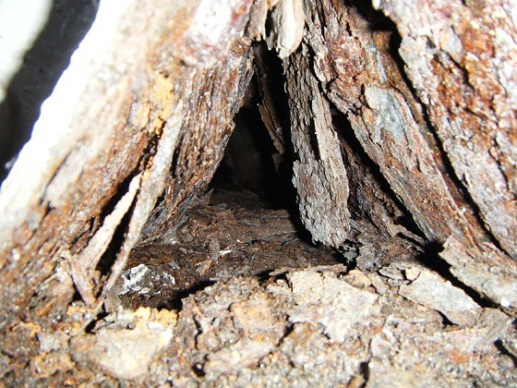
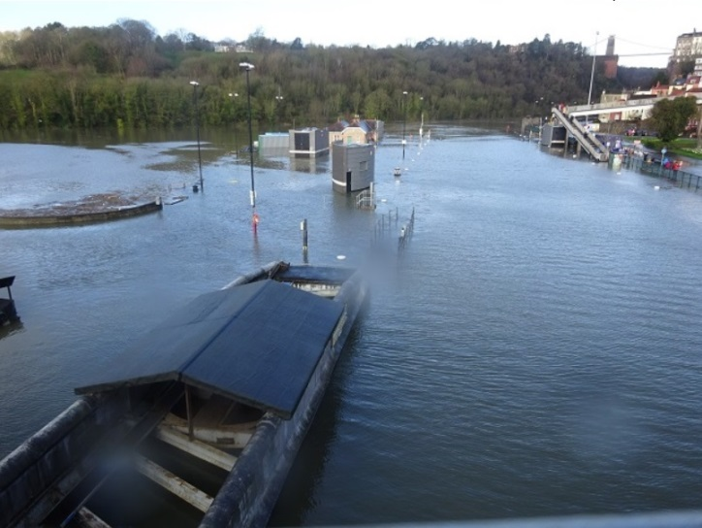
Spot of Corrosion
Some corrosion is visible through the holes
The under surface has lost about 8mm of material from the outside, probably due to salt water action
High tides don’t help
www.brunelsotherbridge.org.uk

Slide 8
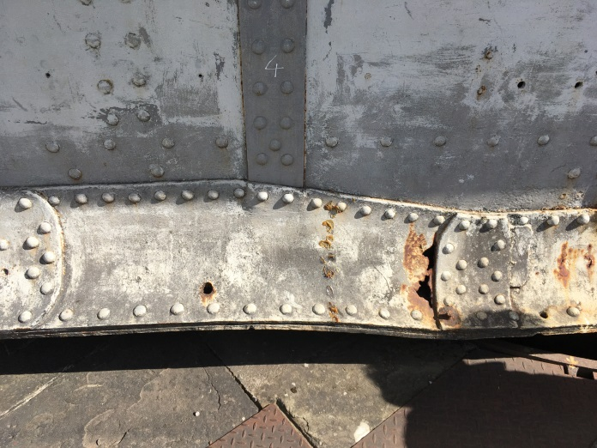
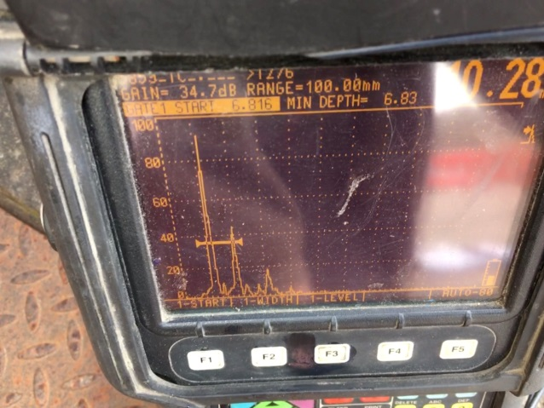
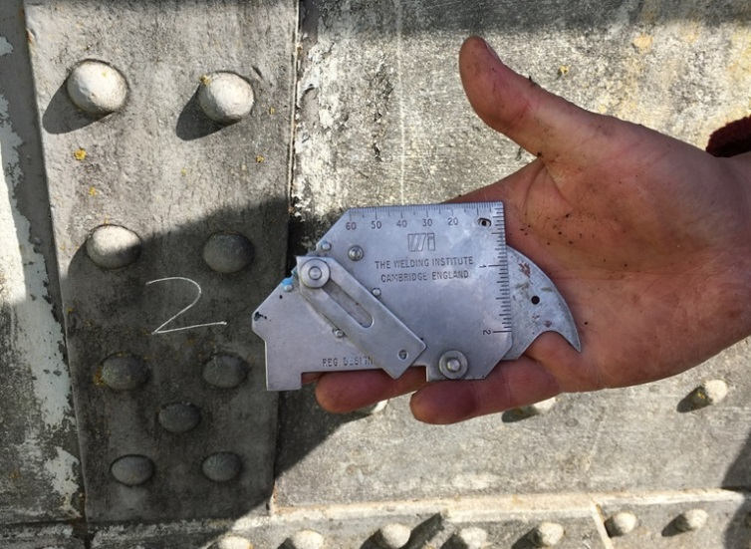
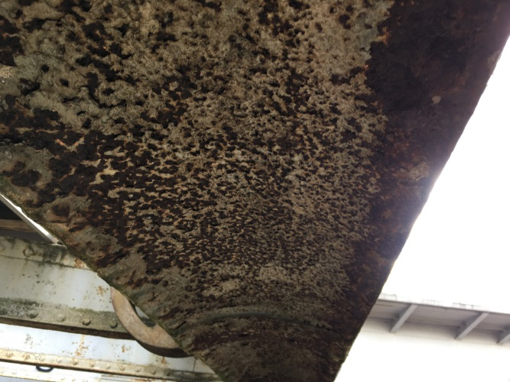
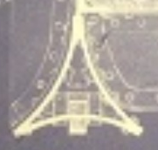
Current results
Richard Day with a 5MHz twin crystal probe
TWI ‘Dent’ gauge on underside
7 to 8mm loss
www.brunelsotherbridge.org.uk

Slide 9
Next steps
10m boroscope inspection of top and bottom internal cavities
Report on UT capability
Trial of Pulsed E/C for plane sections
Agree techniques with the bridge project
Survey the bridge through offering supervised NDT experience to those requiring it for Level 1/2 qualifications.
www.brunelsotherbridge.org.uk

